Slide 1


Solution
Cartoons.jpg
AI Performance: The AI performed well, correctly identifying the image as a "Cartoon," "Fictional Character," and "Animated Cartoon" with high confidence.
Surprising Labels: Labels like "Mammal," "Santa Claus," and "Playing With Kids" were unexpected and inaccurate, showing limitations in distinguishing context and details of animated characters.
SafeSearch: The image was rated "Very Unlikely" for all sensitive content categories, which is appropriate given its benign and family-friendly nature.
Bias Impact: Mislabelling could result in inappropriate tags for media categorisation or search, potentially leading to confusion in content filtering or recommendation systems.
Improvements: Refine datasets to better differentiate between cartoon characters and unrelated contexts (e.g., "Santa Claus"), and improve recognition of animation-specific themes to avoid overgeneralised labels.
Character.jpg
AI Performance: The AI correctly identified the image as a "Cartoon," "Fictional Character," and "Animated Cartoon," aligning well with its visual. style.
Surprising Labels: Some labels like "Happy" and "Gesture" are slightly inaccurate, given the neutral or severe tone of the character. However, they may stem from general assumptions based on cartoon figures.
SafeSearch: SafeSearch flagged the image as "Unlikely" for violence. It has detected the blade within the image, but it does not highlight the potential nature of the object. This may require additional training data to show that it is used for violence.
Bias Impact: Mislabelling emotions (e.g., "Happy") in this context could lead to misleading tags in applications like media classification or content moderation. SafeSearch's mild flagging may also fail to reflect more niche interpretations of potentially concerning imagery.
Improvements: Train AI to understand better contextual elements, like differentiating between stylistic and actual threatening content, and refine emotion-related labels to avoid overly generic tagging.

Slide 2
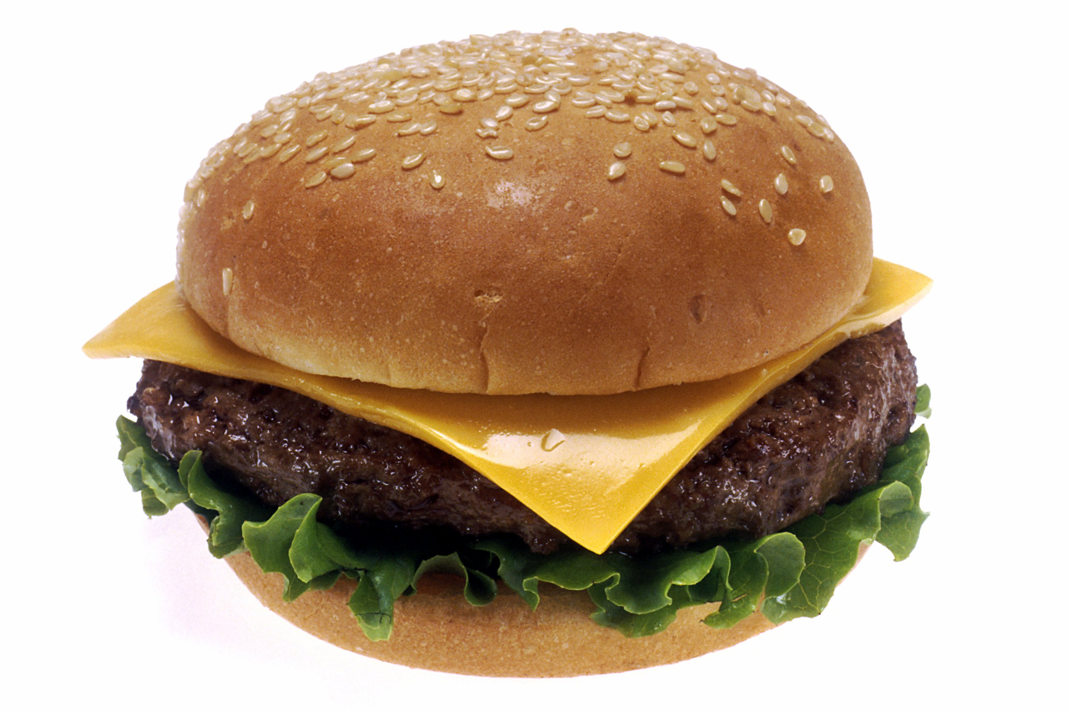
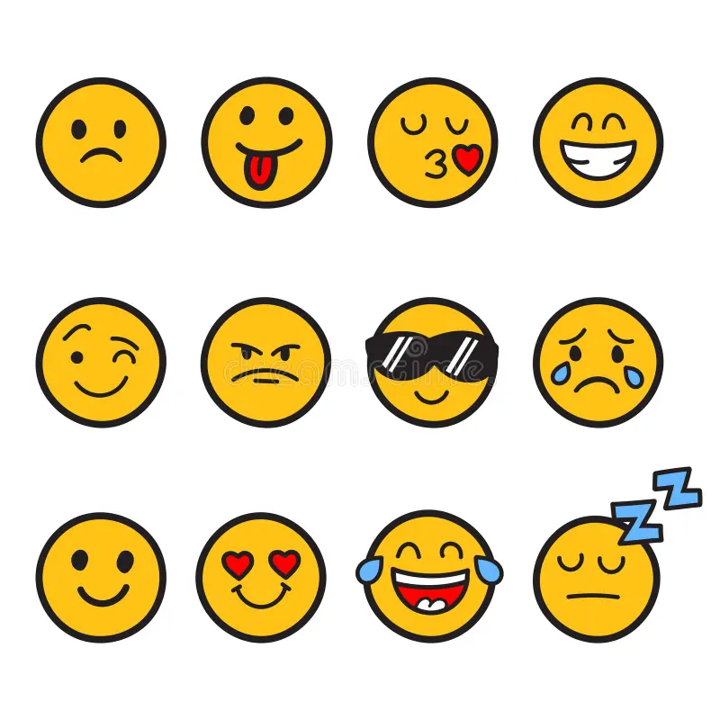
Solution
Cheeseburger.jpg
AI Performance: The AI performed well, correctly identifying the image as "Food," "Hamburger," "Cheeseburger," and related categories like "Fast Food" and "Sandwich" with high accuracy.
Surprising Labels: Some labels like "Veggie Burger," "Buffalo Burger," and "Chicken Tatsuta" are inaccurate and likely stem from confusion with similar-looking dishes. Labels like "Machine" are particularly out of context.
SafeSearch: The image was flagged as "Very Unlikely" for sensitive content like Adult, Violence, and Racy, which is accurate given its harmless and neutral nature.
Bias Impact: Mislabelling could affect product categorisation or search results in food-related applications, leading to confusion for users looking for specific dishes or ingredients.
Improvements: Train AI to better differentiate between similar food items and refine accuracy for niche labels (e.g., specific burger types) to ensure more precise categorisation in food-related datasets.
Emojis.jpg
AI Performance: The AI performed well overall, accurately identifying smiles, emotions, and emoji-related features, but some labels like "Terrestrial Animal" were irrelevant.
Surprising Labels: "Terrestrial Animal" and detecting emoji mouths as "Text" were unexpected and inaccurate.
SafeSearch: The image was flagged as "Very Unlikely" for sensitive content because it contains no elements resembling adult, violent, or racy material.
Bias Impact: Mislabelling could lead to unfair moderation, cultural misunderstandings, and inappropriate tagging in applications like social media.
Improvements: Refine datasets, add contextual learning, improve SafeSearch thresholds, and introduce user feedback to enhance accuracy and fairness.

Slide 3
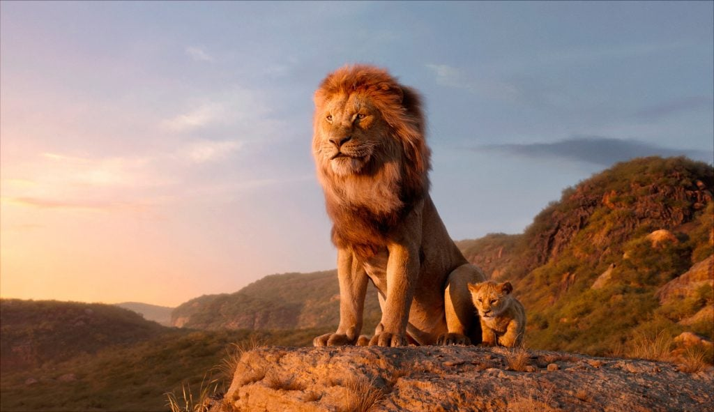
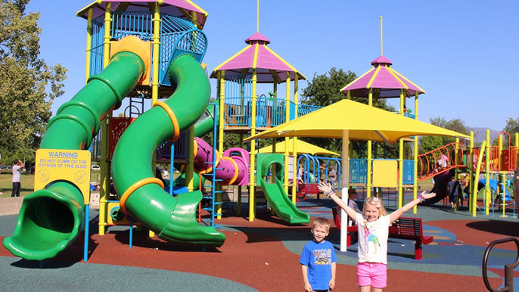
Solution
Lion.jpg
AI Performance: The AI performed well, identifying the primary object as a "Lion" and correctly categorising it with related labels like "Big Cats," "Masai Lion," and "Carnivore."
Surprising Labels: Some labels like "Plant" (70%) and "Tree" (61%) seem irrelevant and likely resulted from the background vegetation being misinterpreted.
SafeSearch: The image was flagged as "Possible" for Racy content, which is surprising as there’s no content in the image that could be interpreted as suggestive or inappropriate.
Bias Impact: Mislabelling (e.g., the "Racy" flag) could lead to unnecessary content moderation in social media or online platforms. At the same time, background misinterpretations (like "Plant") might skew object recognition in wildlife monitoring or similar applications.
Improvements: Refine SafeSearch algorithms to assess content better contextually and avoid overgeneralised flags. Additionally, improve the recognition of background elements to minimise irrelevant labels like "Plant" when it’s not a focal object in the scene.
Park.jpg
AI Performance: The AI accurately identified the primary objects, such as "Playground," "Playground Slide," and "Outdoor Play Equipment," as well as faces with appropriate emotion detection (e.g., "Joy" for one child and neutral for the other).
Surprising Labels: Labels like "Amusement Park" and "Public Event" are somewhat inaccurate as the setting appears to be a local playground, not an event or park attraction. The repeated "Person" labels with slightly varying percentages add redundancy.
SafeSearch: The image was correctly flagged as "Very Unlikely" for all sensitive content categories, reflecting the harmless nature of the image.
Bias Impact: Mislabelling could affect applications like photo categorisation or tagging, where distinguishing between a playground and an amusement park might matter. Incorrect assumptions about "events" could skew recommendations or organisational tools.
Improvements: Refine contextual understanding of settings to differentiate between a playground and larger attractions like amusement parks. Address redundancy in object detection (e.g., multiple "Person" labels) for more streamlined labelling.

Slide 4


Solution
Scenery.jpg
AI Performance: The AI performed well, accurately identifying key elements such as "Cloud," "Water," "Sky," "Natural Landscape," and "Sunlight" with high confidence. These labels align well with the scenic content of the image.
Surprising Labels: Some labels, such as "Winter" (57%) and "Lake" (56%), are inaccurate and likely stem from confusion due to the general presence of water and atmospheric effects.
SafeSearch: The image was correctly flagged as "Very Unlikely" for all sensitive content categories, reflecting its peaceful and neutral nature.
Bias Impact: Mislabelling elements like "Winter" or "Lake" in a coastal image could lead to incorrect categorization in applications such as geotagging or stock photo databases.
Improvements: Improve differentiation between types of water bodies (e.g., ocean vs. lake) and refine atmospheric recognition to avoid irrelevant seasonal labels like "Winter" for non-winter scenes.
Yoga.jpg
AI Performance: The AI performed well in recognising key objects and context, such as "Yoga Mat," "Water," "Sky," "Human Body," and "Physical Fitness," which align with the activity and setting. It also detected faces accurately, although with low confidence on expressions like "Joy."
Surprising Labels: Labels like "Flash Photography," "Performing Arts," and "Undergarment" (listed twice) seem irrelevant or inaccurate in the context of a yoga activity. The "Racy" flag in SafeSearch appears unwarranted, as the image depicts a neutral activity.
SafeSearch: The "Racy" label flagged as "Very Likely" seems to overinterpret elements of the clothing or poses, which could result from bias in interpreting human forms or minimal clothing, even in inappropriate contexts like yoga.
Bias Impact: Mislabelling as "Racy" could lead to inappropriate content moderation on social media or public platforms, even when the content is harmless and appropriate. Similarly, inaccurate labels like "Performing Arts" could misrepresent the activity.
Improvements: Refine SafeSearch sensitivity to better differentiate between contextually appropriate activities like yoga and potentially sensitive content. Additionally, streamline object recognition to eliminate redundant or irrelevant labels, such as "Undergarment" and "Performing Arts," for greater accuracy.

